Slide 1


ARTIFICIAL INTELLIGENCE WITHOUT BORDERS

Slide 2

Linear correlation and Linear regression
Linear regression is perhaps one of the most well known and well understood algorithms in statistics and machine learning.
In this post you will discover the linear regression algorithm, how it works and how you can best use it in on your machine learning projects. In this post you will learn:
Why linear regression belongs to both statistics and machine learning.
The many names by which linear regression is known.
The representation and learning algorithms used to create a linear regression model.
How to best prepare your data when modeling using linear regression.
AILABS Property, All rights reserved

Slide 3
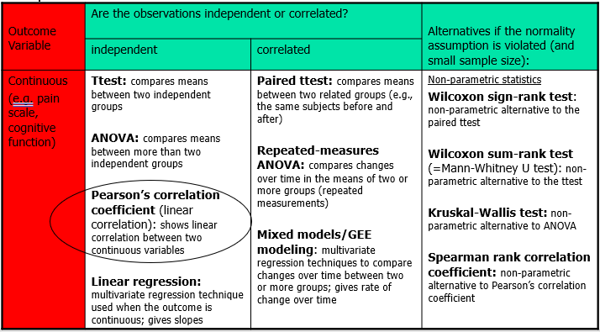
Continuous outcome (means)
AILABS Property, All rights reserved

Slide 4
Recall: Covariance
Covariance provides insight into how two variables are related to one another. More precisely, covariance refers to the measure of how two random variables in a data set will change together. A positive covariance means that the two variables at hand are positively related, and they move in the same direction.
AILABS Property, All rights reserved

Slide 5
Interpreting Covariance
Cov(X,Y) > 0 X and Y are positively correlated
Cov(X,Y) < 0 X and Y are inversely correlated
Cov(X,Y) = 0 X and Y are independent
AILABS Property, All rights reserved

Slide 6
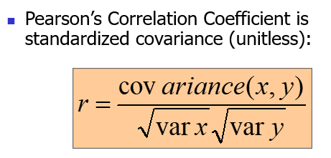
Correlation coefficient
AILABS Property, All rights reserved

Slide 7
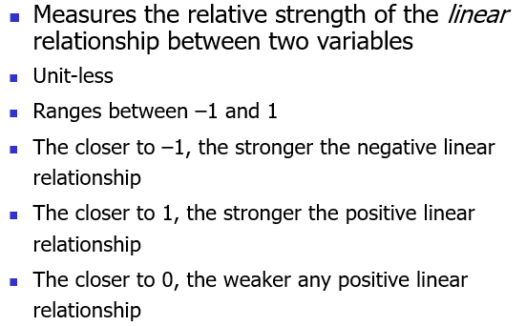
Correlation
AILABS Property, All rights reserved

Slide 8
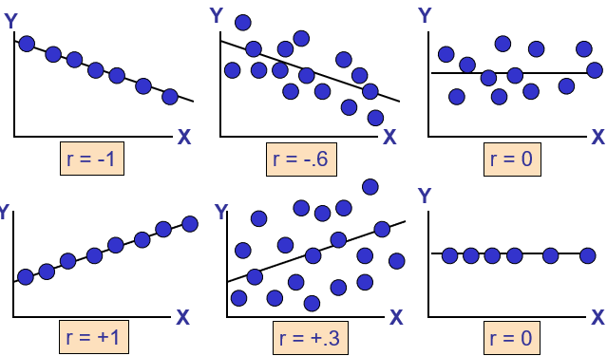
Scatter Plots of Data with Various Correlation Coefficients
AILABS Property, All rights reserved

Slide 9
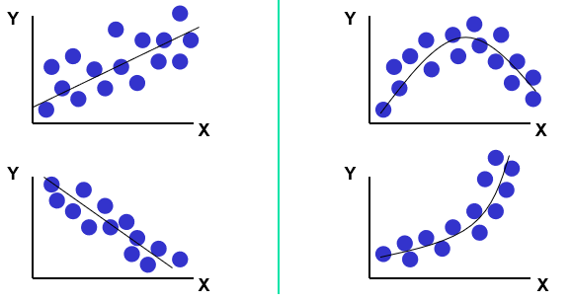
Linear Correlation
AILABS Property, All rights reserved

Slide 10
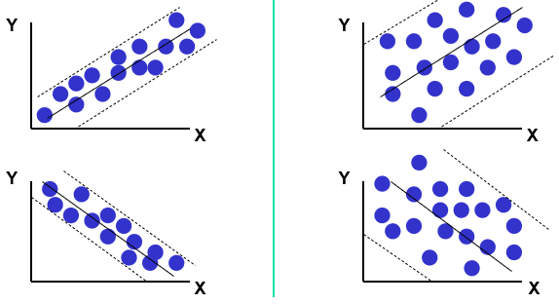
Linear Correlation
AILABS Property, All rights reserved

Slide 11
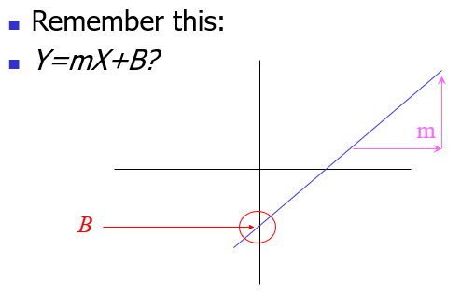
What is “Linear”?
AILABS Property, All rights reserved

Slide 12
What’s Slope?
A slope of 2 means that every 1-unit change in X yields a 2-unit change in Y.
Prediction
If you know something about X, this knowledge helps you predict something about Y. (Sound familiar?…sound like conditional probabilities?)
AILABS Property, All rights reserved

Slide 13

Regression equation…
AILABS Property, All rights reserved

Slide 14
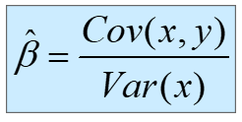

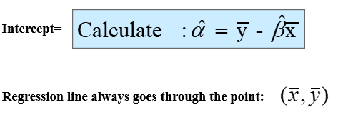
Resulting formulas…
AILABS Property, All rights reserved

Slide 15
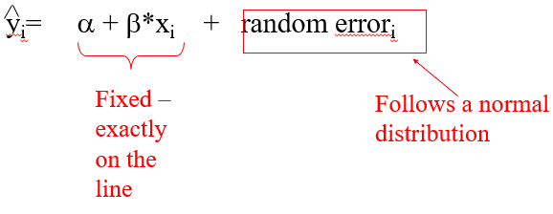
Predicted value for an individual…
AILABS Property, All rights reserved

Slide 16
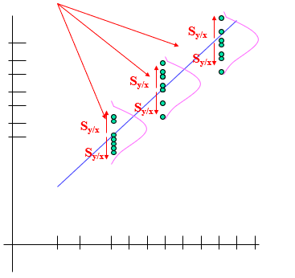
The standard error of Y given X is the average variability around the regression line at any given value of X.
AILABS Property, All rights reserved

Slide 17
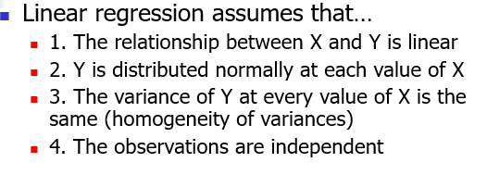
Assumptions (or the fine print)
AILABS Property, All rights reserved

Slide 18
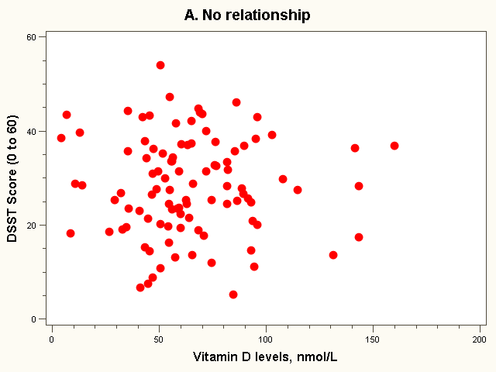
No Relationship
AILABS Property, All rights reserved

Slide 19
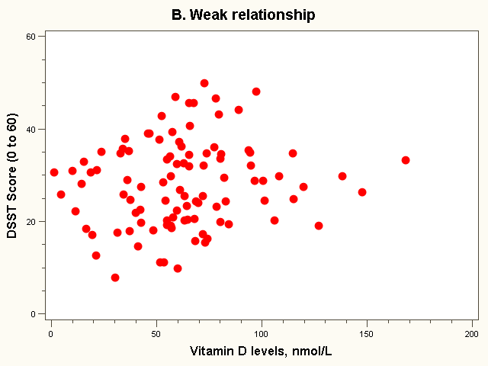
Weak Relationship
AILABS Property, All rights reserved

Slide 20
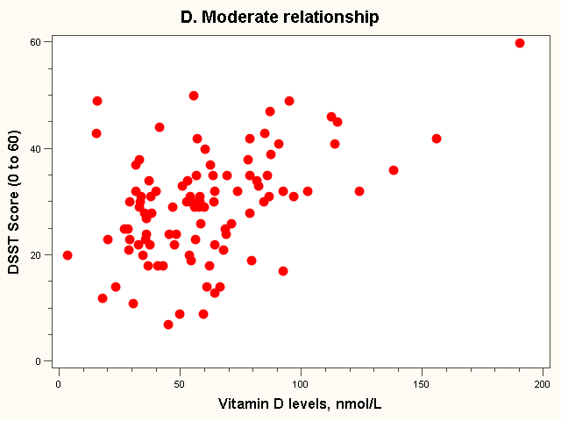
Moderate Relationship
AILABS Property, All rights reserved

Slide 21
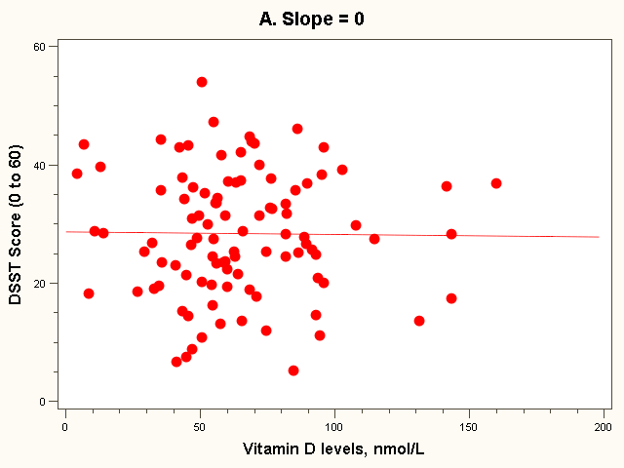
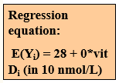
The “Best fit” line
AILABS Property, All rights reserved

Slide 22
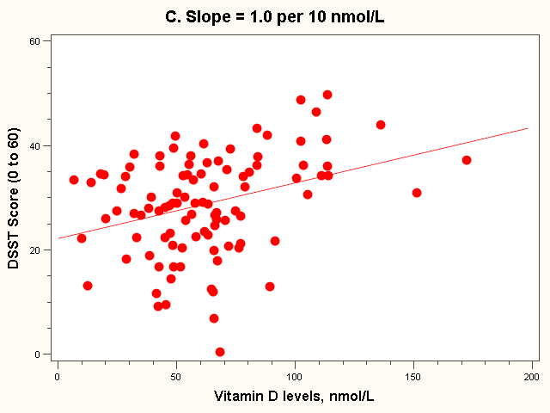

The “Best fit” line
AILABS Property, All rights reserved

Slide 23
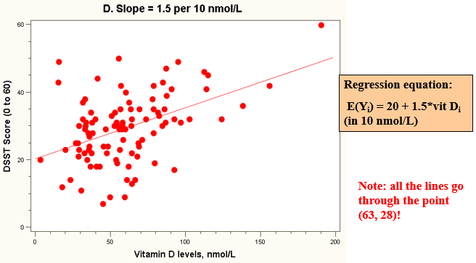
The “Best fit” line
AILABS Property, All rights reserved

Slide 24

Thank You

